Slide 1
GUI Testing

Slide 2
UI functional tests
run on an actual browser
mimic the user actions in the application.
give us feedback on the integration between multiple components
Are macro-level
focus on validating all the critical user flows
Notes:
UI-driven functional tests are run on an actual browser and mimic the user actions in the application. These tests give us feedback on the
integration between multiple components, such as services, the UI, and the DB. These macro-level tests should focus on validating all
the critical user flows. One example of a critical user flow in the ecommerce application is searching for a product, adding the
product to the cart, paying for the product, and getting an order confirmation. This can be added as a UI functional test. When writing
such tests, avoid validating the same details covered as part of the lower-level micro tests again, as this will be redundant and increase
their execution time. For instance, verifying the order totals for different combinations of item prices should be covered by unit tests
and needn’t be validated again as part of a UI functional test. UI functional tests are usually kept apart from the application code
as a separate code base. They mainly come under the tester’s purview, although they may be jointly owned with developers. These
tests take longer to run and tend to be brittle, as they depend on the entire application stack’s behavior, including the infrastructure,
network, and so on, being stable. Additionally, they require considerable maintenance effort compared to other types of tests as
failures could happen anywhere across the entire application—for example, a change in an element ID, a delay in page load, or
unavailability of services due to environment issues. Tools like Selenium and Cypress are popularly adopted to write
automated UI tests. You’ll find exercises for both of them later in the chapter.
Resource: Full Stack Testing book (chapter 3)

Slide 3
UI functional tests
Vs
End-to-end tests
end-to-end tests should validate the entire breadth of your domain workflow, including downstream systems. mimic the user actions in the application.
Depending on the application context, the UI functional tests often tend to become end-to-end tests. If not, create separate end-to-end tests using a combination of UI, service, and DB testing tools to cover the entire integration flow.
Notes:
end-to-end tests should validate the entire breadth of your domain workflow, including downstream systems. In the ecommerce application, after an order is placed on the website, the downstream systems (such as the warehouse management system, third-party shipping partner services, and so on) actually
fulfill the order. This end-to-end domain flow needs to be tested for proper integration. Depending on the application context, the UI functional tests often
tend to become end-to-end tests. If not, create separate end-to-end tests using a combination of UI, service, and DB testing tools to cover the entire integration flow. Obviously, these tests take the longest time to run and require more care in maintaining, as they need a stable environment and test data setup across various systems. The intent of these tests is to determine whether all the components are integrated properly end to end, and not to test the
components’ functionalities. So, you can just have a few tests that will activate all your components.
Resource: Full Stack Testing book (chapter 3)

Slide 4
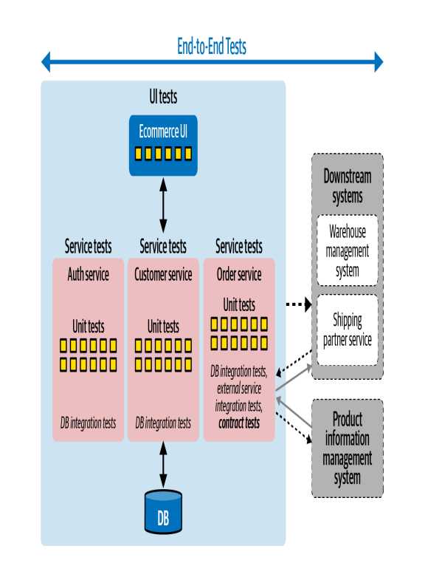
UI functional tests
VS
End-to-end tests
VS
Unit tests
Notes:
Resource: Full Stack Testing book (chapter 3)

Slide 5
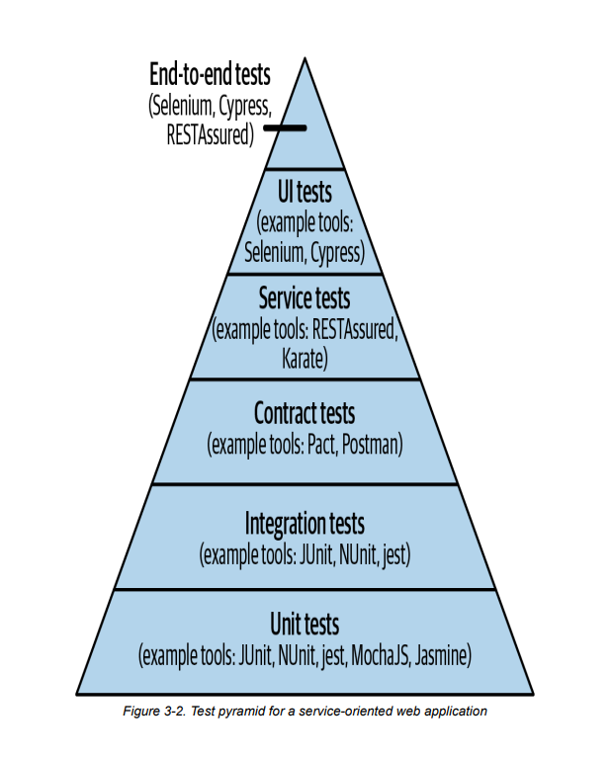
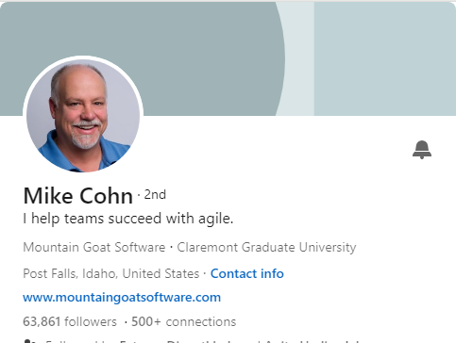
Test pyramid for a service-oriented web application
Notes:
Mike Cohn crystallized this nicely with a visual cue in his 2009 book Succeeding with Agile (Addison-Wesley Professional) as the test pyramid concept. The test pyramid recommends having a broad bucket of micro-level tests and gradually reducing the number of macro-level tests as their scope increases. For example, if you have 10x unit and integration tests, you should have 5x service tests and only x UI-driven tests. If you layer these one on top of another, with the unit tests at the bottom, they form a pyramid. The obvious reason for such a recommendation is that as the scope of the tests increases, they take more time to run and cost more to write and maintain
a few E2E tests will activate all your components
Although the test pyramid can be thought of as the ideal to pursue, there may be situations where it is not possible to achieve a true pyramid shape. This can be due to practical pitfalls, such as lack of a fully deployed test environment to support end-to-end tests, or lack of tools to automate certain kinds of functionalities (such as barcode scanning), or, bluntly, lack of skills. In such cases, the team should be mindful of the trade-offs they are making and choose the quantity and types of tests in such a way that they can still achieve the goal of getting fast feedback, despite these constraints.
Resource: Full Stack Testing book (chapter 3)

Slide 6
Automated tests
Vs
Manual tests
Manual tests | Automated tests
Requires human intervention. | Use tools to execute tests.
Requires skilled labor, long time and costs. | Save manpower, times, and cost
Any type of application can be tested. | Recommended only for stable systems.
Can become repetitive and boring. | Boring part of execution handled by tools.

Slide 7
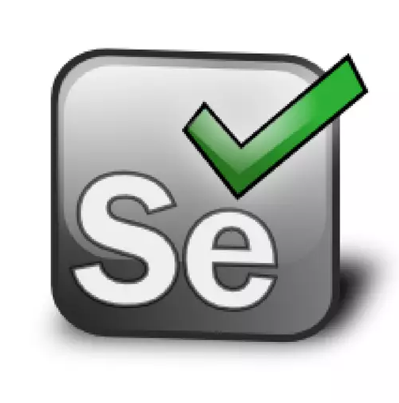
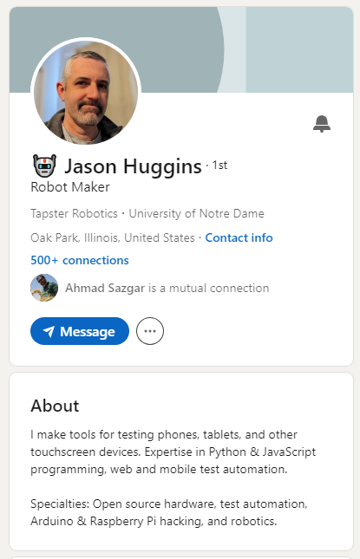
Selenium
An open source automated testing tool for web application.
Jason Huggins building the Core mode as "JavaScriptTestRunner" in 2004.
Paul Hammant saw the demo, and started discussions about the open sourcing of Selenium
Notes:
The story starts in 2004 at ThoughtWorks in Chicago, with Jason Huggins building the Core mode as "JavaScriptTestRunner" for the testing of an internal Time and Expenses application (Python, Plone). Automatic testing of any applications is core to ThoughtWork's style, given the Agile leanings of this consultancy. He has help from Paul Gross and Jie Tina Wang. For them, this was a day job. Soon after in 2004 fellow ThoughtWorker Paul Hammant saw the demo, and started discussions about the open sourcing of Selenium

Slide 8
Selenium main features
Open source.
Supports many languages.
Suppurts many browsers.
Supports many operating systems.
Flexible.

Slide 9
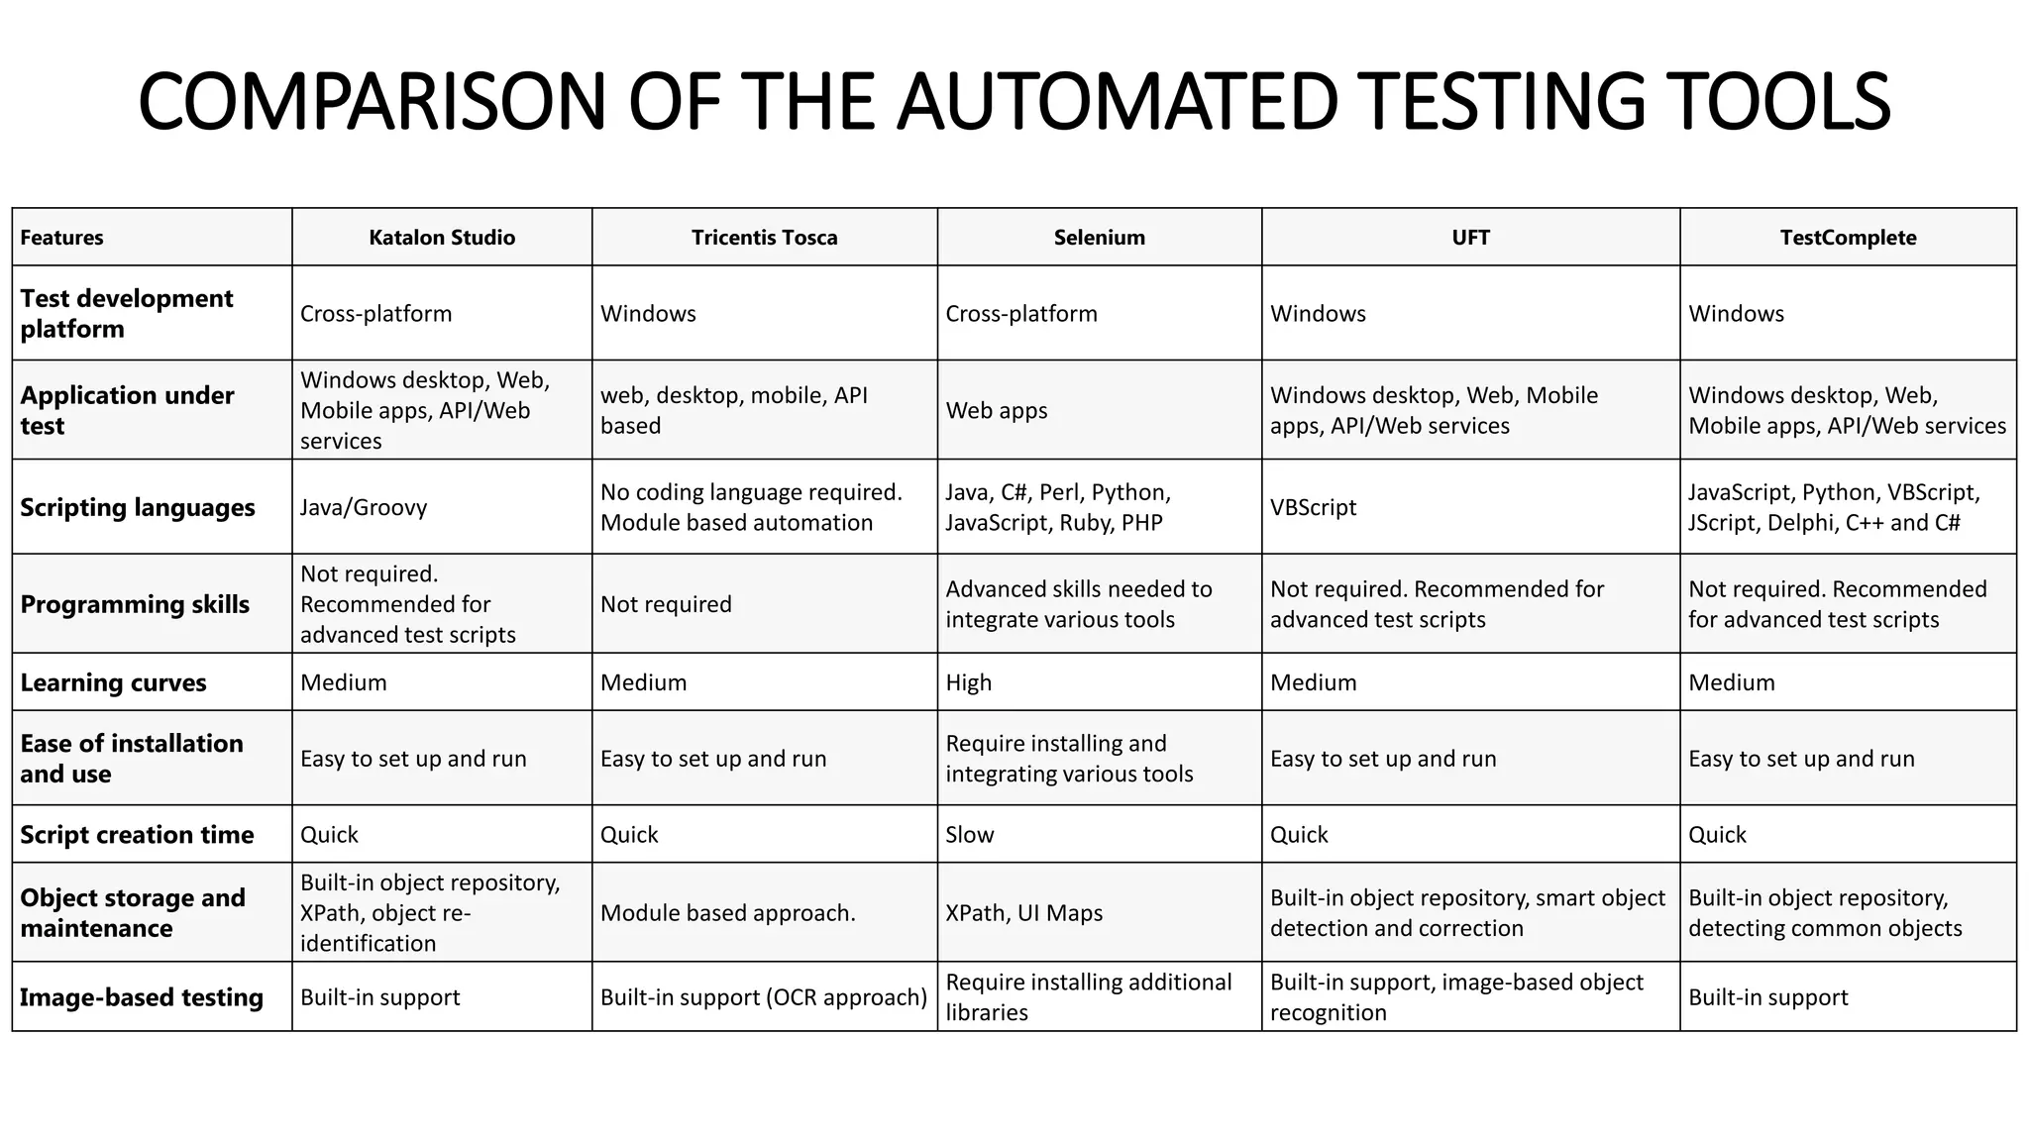

Slide 10
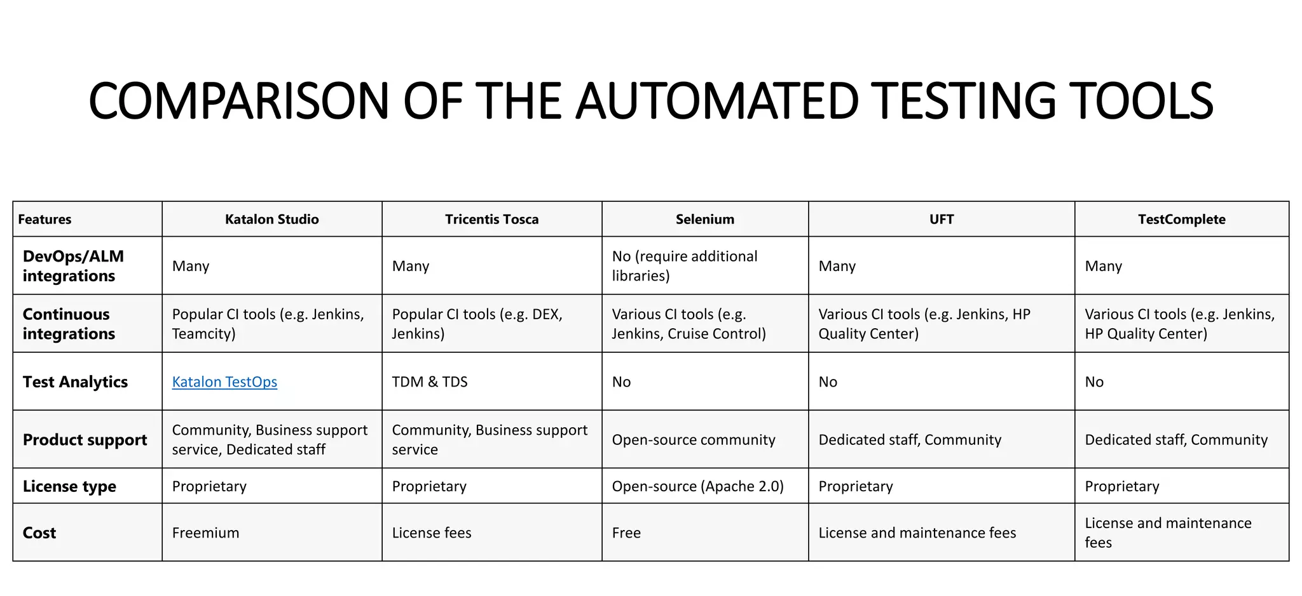

Slide 11
Selenium Components
Selenium integrated development environment (IDE)
Selenium remote control (RC)
Webdriver
Selenium Grid

Slide 12
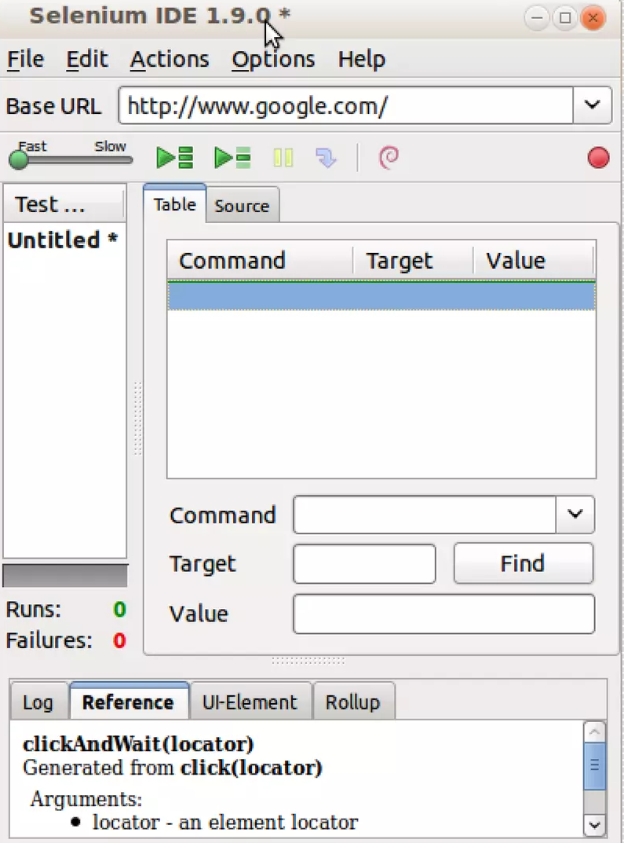
Selenium IDE
Only Firefox extension.
Easy record and replay.
Debug and set breakpoints.
Selenium Grid

Slide 13
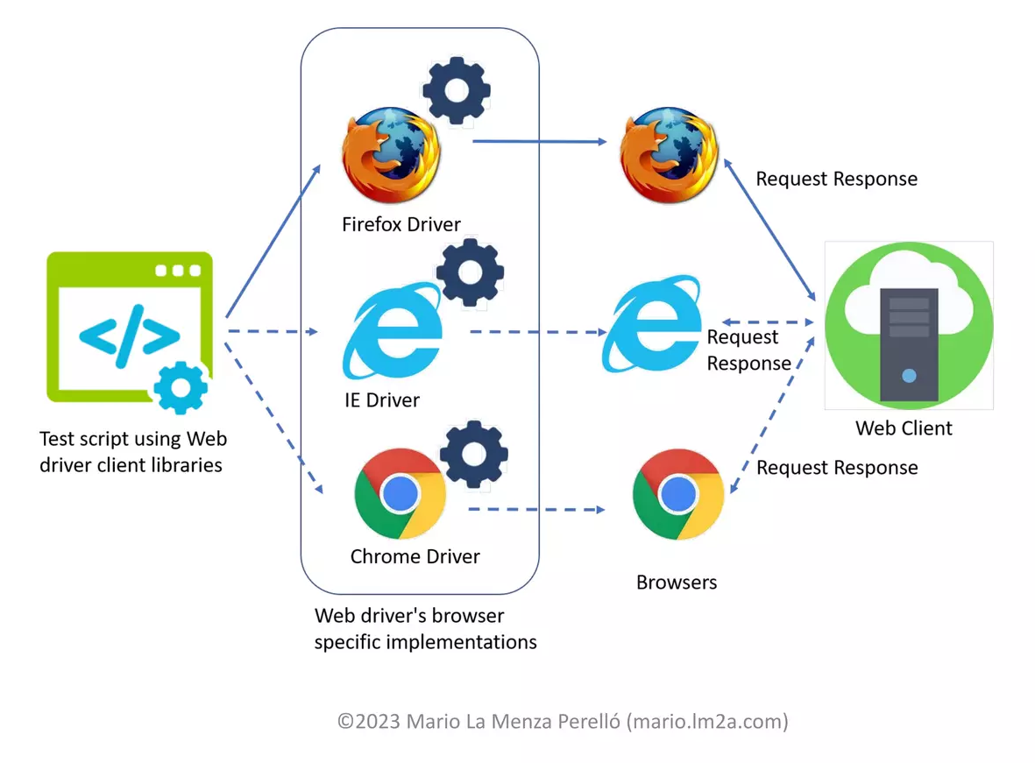
Selenium Webdriver
Webdriver is a browser automation framework that accepts commads and sends them to browsers.

Slide 14
Selenium Webdriver
A program
Designed to provide simpler and uniformed interface
Control broeser by programming
Supports multiple browsers in multiple platforms
Chrome
Internet explorer
Firefox
Opera
Andriod
iOS

Slide 15
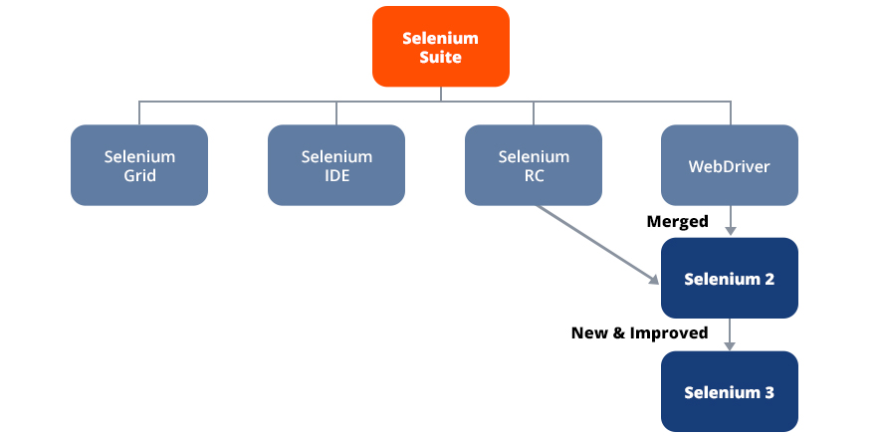

Slide 16
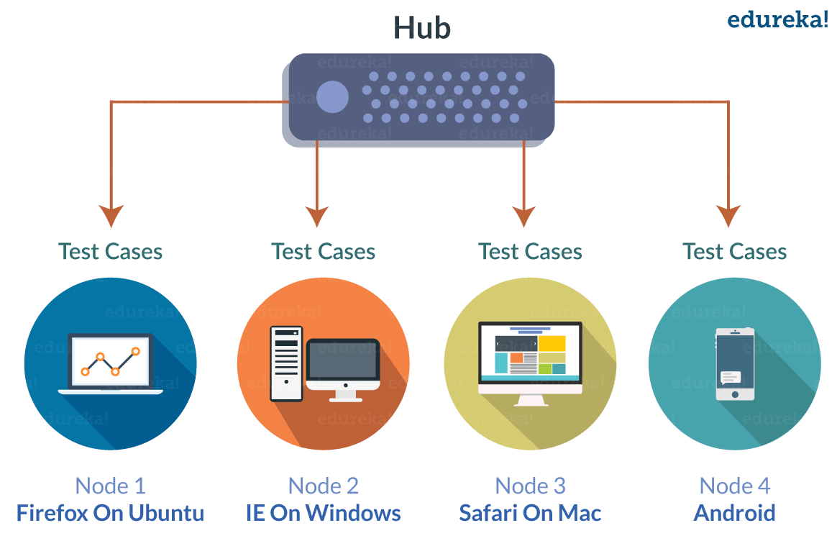
Selenium Grid
Distributed test execution on several machines

Slide 17
Write Test Selenium

Slide 18
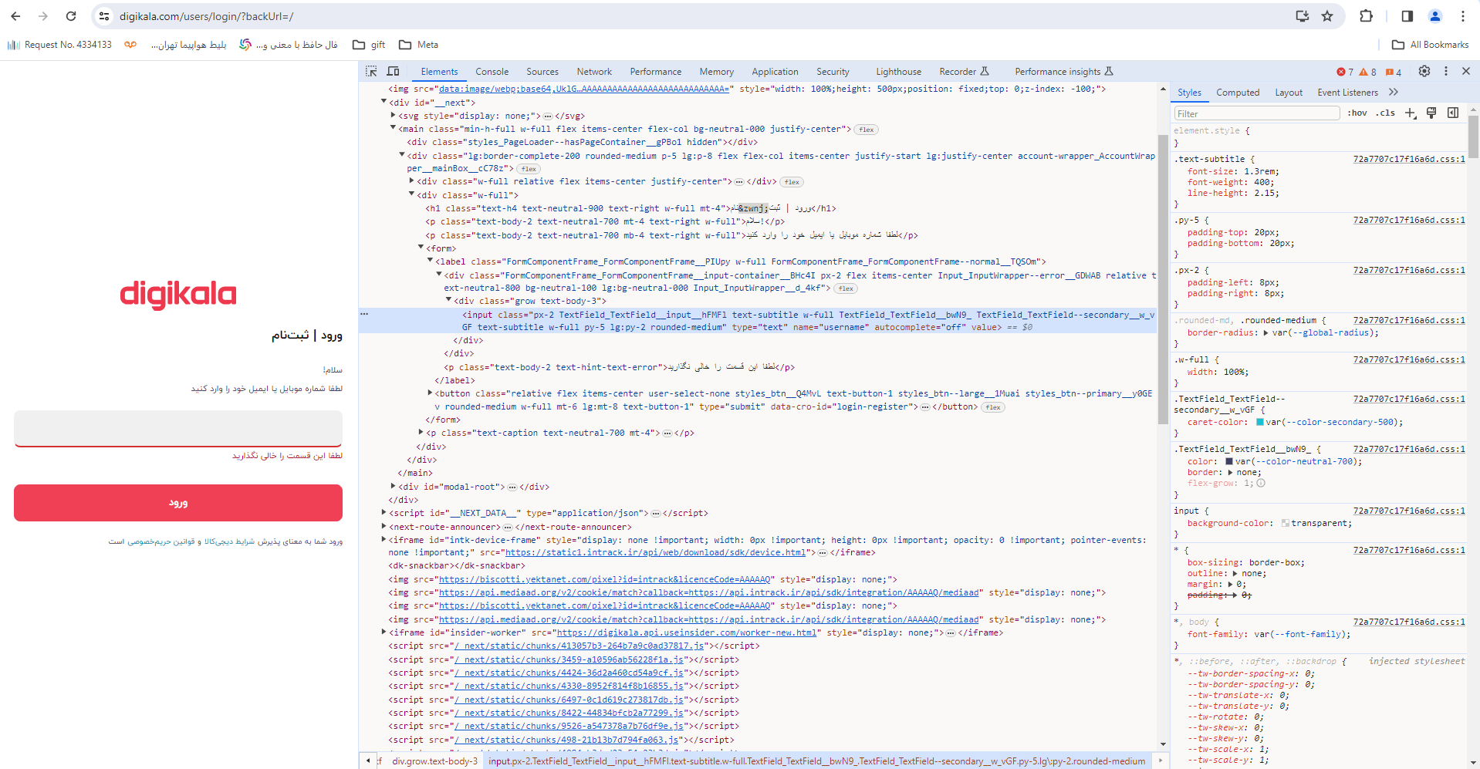
Web element
Anything presented in webpage
Box
Labels
Button
dropdown

Slide 19
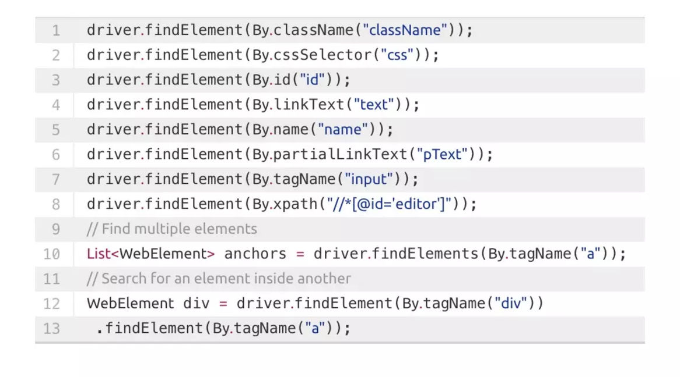
Web element
They are identified by locators
id
Name
class
xpath

Slide 20
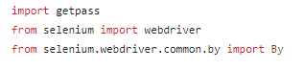
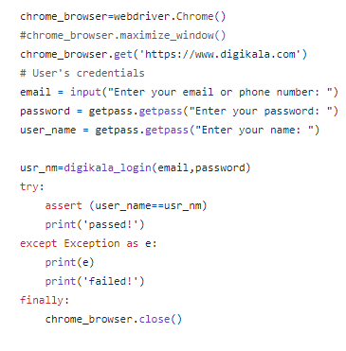
Simple Login example

Slide 21
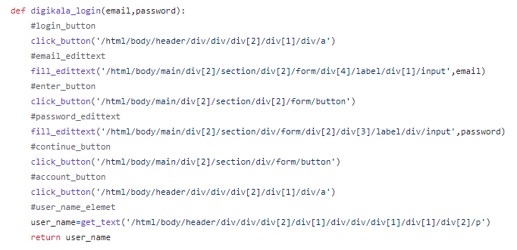
Simple Login example

